Slide 1


Project Lambda
Deploying Python code to AWS

Slide 2
What is Project Lambda?
(Also, why are you making me do this?)
An opportunity to learn
A group project where everyone is learning something new.
An opportunity to teach
We’ll divide up the work and teach each other what we’ve learned.
An opportunity to collaborate
We’ll build something together and then give a demo to Analytics.
A way to shake things up a bit
This should be a fun diversion from the other projects we’ve been working on. :-)
✅
✅
✅
✅

Slide 3
Project Overview
What will we do?
Build Python code that creates metrics from medical and pharmacy claims.
Deploy this code to a Lambda function.
Enable access through an API Gateway.
How will we do it?
We’ll dedicate time from the workday over the next 2 sprints to focus on this project.
We’ll divide up the work.
We’ll meet twice a week on Tuesdays (45m) and Thursdays (45m) and as needed in between.

Slide 4
Architecture

Slide 5
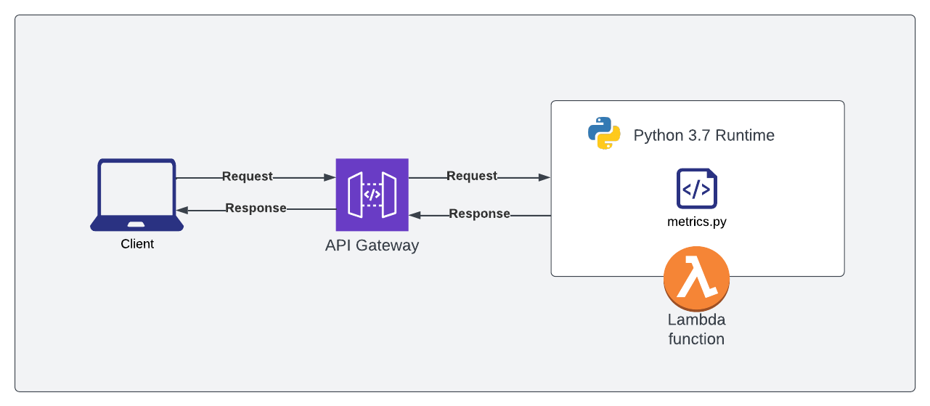
Design overview
Technology
API Gateway - Amazon API Gateway is a fully managed service that makes it easy for developers to create, publish, maintain, monitor, and secure APIs at any scale. APIs act as the "front door" for applications to access data, business logic, or functionality from your backend services.
Lambda Function - AWS Lambda is a serverless, event-driven compute service that lets you run code for virtually any type of application or backend service without provisioning or managing servers.
Terminology
Runtime describes software/instructions that are executed while your program is running, especially those instructions that you did not write explicitly, but are necessary for the proper execution of your code.
Request - HTTP defines a set of request methods to indicate the desired action to be performed for a given resource. (We will start with the POST method.)

Slide 6
Python metrics

Slide 7
Requirements for a metrics script
Accept and parse a JSON of medical and pharmacy claims data (1 or many members)
We should be prepared to process a single member or a batch of up to 500 members
This will require upfront design work
Calculate metrics
Everyone will choose a metric to code up in Python
Build and return a JSON response
This will require upfront design work

Slide 8
Choosing your metric
Flag Admissions
Step 1: Limit to Institutional claims using claim_type = ‘I’
Step 2: Limit type_of_bill = 011X or 012X
Logic: Second 1 indicates hospital; Third indicates Inpatient Part A (1) or Part B (2)
Step 3 : Limit to claims with UB revenue codes for inpatient services (0100 - 0219, 1000 - 1009)
Step 4: Count distinct discharge_date at the claims header level
Next version: Flag Readmissions

Slide 9
AWS

Slide 10
Building our architecture is easier than it sounds
Once we’re ready to test our code, we’ll:
Set up a Lambda function in AWS
Deploy our Python code
Create and configure an API Gateway to invoke our Lambda function
Implement access control (API Key) to prevent unauthorized access
Test our work

Slide 11
Demo
Notes:
curl -X GET https://ctxkde5661.execute-api.us-east-1.amazonaws.com/beta -H 'x-api-key: mcBkWftQ2p9s0Mhqf8Yni9EfdL8h2JX14HHUFGvJ'

Slide 12
Learning Concepts
Python - Process medical claims to create and return metrics
Concepts applied: Conditionals (if else), loops, list comprehension, Object Oriented Programming
Healthcare Concepts - Types of Billing (Institutional vs Professional), Types of Codes (Revenue vs Procedure vs Diagnosis)
Revenue codes are used on hospital bills to tell the payers (insurance companies) where the patient was when they received treatment (room and board).
Procedure codes (CPT codes) are used by healthcare providers to describe the services they provided to the insurance companies for payment.
Diagnosis codes (ICD-10 codes) describe the patient's medical condition and are required on claims submitted by healthcare professionals to the payers.
REST APIs - What are they and how can we interact with them?
JSON - Build a JSON structure for medical claims / Return a JSON structure with metrics
AWS (Lambda & API Gateway) - Set up a Lambda function and API Gateway in AWS

Slide 13
Retrospective
What went well?
Introduced and learned how to apply lots of new concepts (see previous slide)
Enthusiasm to learn, experiment, and fail is still present months later
Realizations
Recognizing that new concepts take time to understand and apply
Advice: To be kinder on myself Was hard on myself on understanding them more quickly
Consistency is key
Dedicated 30– 60 minutes every day to learning and apply concepts in code
Balance between working through problems independently and bringing in others with truly stuck

Slide 14
Next steps
Notes:
curl -X GET https://ctxkde5661.execute-api.us-east-1.amazonaws.com/beta -H 'x-api-key: mcBkWftQ2p9s0Mhqf8Yni9EfdL8h2JX14HHUFGvJ'

Slide 15
Tentative timeline
Week 1
4/26 - Project kick-off / Choose and Research your metric
Bring a list of requirements (Exs: Diagnosis codes, CPT codes) to Thursday’s sync (4/28)
Grab time with Gary / Rich if you want to discuss
4/28 - Create claims JSON structure (working session)
Week 2
6/7 - Recap and next steps / Chien to build find_and() class method
6/9 - Work on individual metrics
Week 3
6/14 - Review our individual metrics
6/16 - Architecture build
Week 4
6/21 - Project Retrospective
6/23 - Demo! (optional)

Slide 16
Appendix
Notes:
curl -X GET https://ctxkde5661.execute-api.us-east-1.amazonaws.com/beta -H 'x-api-key: mcBkWftQ2p9s0Mhqf8Yni9EfdL8h2JX14HHUFGvJ'

Slide 17
Claims JSON
// JSON structure of a single member's claims
{
"member_id": "MEMBER123",
"member_age": 45,
"member_sex": "F",
"claims": [
{
"claim_id": "claim_x23123", // Internally generated
"claim_type": "I", // I: Institutional, P: Professional, R: Pharmacy(Rx)
"type_of_bill": "0111",
"admission_date": "2022-04-01",
"discharge_date": "2022-04-05",
"taxonomy_code": "A0001X35534",
"place_of_service": "21",
"diagnosis_codes": [
"A00.1",
"I29"
],
"claim_lines": [
{
"line_number": 1,
"revenue_code": "0250",
"procedure_code": "J2345",
"service_date": "2022-04-01",
"ndc_code": "",
"units": 0,
"allowed_amount": 155.50
},
{
"line_number": 2,
"revenue_code": "0251",
"procedure_code": "J2345",
"service_date": "2022-04-01",
"ndc_code": "",
"units": 0,
"allowed_amount": 1000.50
}
]
}
]
}

Slide 18
Control Flow
// JSON structure of a single member's claims
{
"member_id": "MEMBER123",
"member_age": 45,
"member_sex": "F",
"claims": [
{
"claim_id": "claim_x23123",
"claim_type": "I",
"type_of_bill": "0111",
"admission_date": "2022-04-01",
"discharge_date": "2022-04-05",
"taxonomy_code": "A0001X35534",
"place_of_service": "21",
"diagnosis_codes": [
"A00.1",
"I29"
],
"claim_lines": [
{
"line_number": 1,
"revenue_code": "0250",
"procedure_code": "J2345",
"service_date": "2022-04-01",
"ndc_code": "3334445556",
"units": 0,
"allowed_amount": 155.50
}
]
}
]
}
KEY | Value
CONTENTS0MEMBER0MEMBER_ID | MEMBER123
CONTENTS0MEMBER0MEMBER_AGE | 45
CONTENTS0MEMBER0MEMBER_SEX | F
CONTENTS0MEMBER0CLAIM0LINE0PROCEDURE_CODE | 99214
CONTENTS0MEMBER0CLAIM0LINE0SERVICE_DATE | 04-01-2022
CONTENTS0MEMBER0CLAIM0LINE0NDC_CODE | 3334445556

Slide 19
Building a ‘Hash’ from JSON
Build an object from the JSON that can be easily traversed and queried
Unique keys for each JSON value; in a DICT[ionary] object
Naturally fast traversals with dictionaries in Python (as they are hashed).
{
"batch_id":"long_allyears",
"sequence":1,
"contents":[
{
"member_id":"mbr_002313701",
"member_age":48,
"member_sex":"F",
"claim":[
{
"claim_id":"clm_701224700",
"claim_type":"P",
"type_of_bill":null,
"admission_date":"2019-02-12",
"discharge_date":"2019-02-12",
"taxonomy_code":"363A00000X",
…
{
"batch_id":"long_allyears",
"sequence":1,
"contents.0.member_id":"mbr_002313701",
"contents.0.member_age":48,
"contents.0.member_sex":"F",
"contents.0.claim.0.claim_id":"clm_701224700",
"contents.0.claim.0.claim_type":"P",
"contents.0.claim.0.admission_date":"2019-02-12",
"contents.0.claim.0.discharge_date":"2019-02-12",
"contents.0.claim.0.taxonomy_code":"363A00000X",
"contents.0.claim.0.place_of_service":11,
"contents.0.claim.0.principle_diagnosis":"F909",
"contents.0.claim.0.diagnosis_codes.0":"F909",
"contents.0.claim.0.claim_line.0.line_number":1,
"contents.0.claim.0.claim_line.0.from_date":"2019-02-12",
"contents.0.claim.0.claim_line.0.thru_date":"2019-02-12",
…

Slide 20

JSON Hash function
Input parameter: dictionary (JSON)
Iterates through each key/value in
Identifies object type ( & hierarchy) -> dictionary, list, value
If dictionary or list then recurse
If list then enumerate the item position (0…n) which will be part of hash key
P_sparse - Rich’s secret sauce to keep this thing manageable with large JSON (removes null values)
def json_hash(p_dictionary, p_parent_key=False, p_sparse=False):
_items = []
for _key, _value in p_dictionary.items():
_new_key = str(p_parent_key) + '.' + _key if p_parent_key else _key
if isinstance(_value, MutableMapping):
# it's a dictionary
if not _value.items():
# check for empty dictionary
_items.append((_new_key, None))
else:
# not empty, recurse!
_items.extend(json_hash(_value, _new_key, p_sparse).items())
elif isinstance(_value, list):
# it's a list, so check to see if it's [not] empty
if len(_value):
for _k, _v in enumerate(_value):
_items.extend(json_hash({str(_k): _v}, _new_key, p_sparse).items())
else:
# empty list
_items.append((_new_key, None))
else:
# not dict or list, so append key, value
if p_sparse is True and _value is None:
continue
_items.append((_new_key, _value))
return dict(_items)

Slide 21
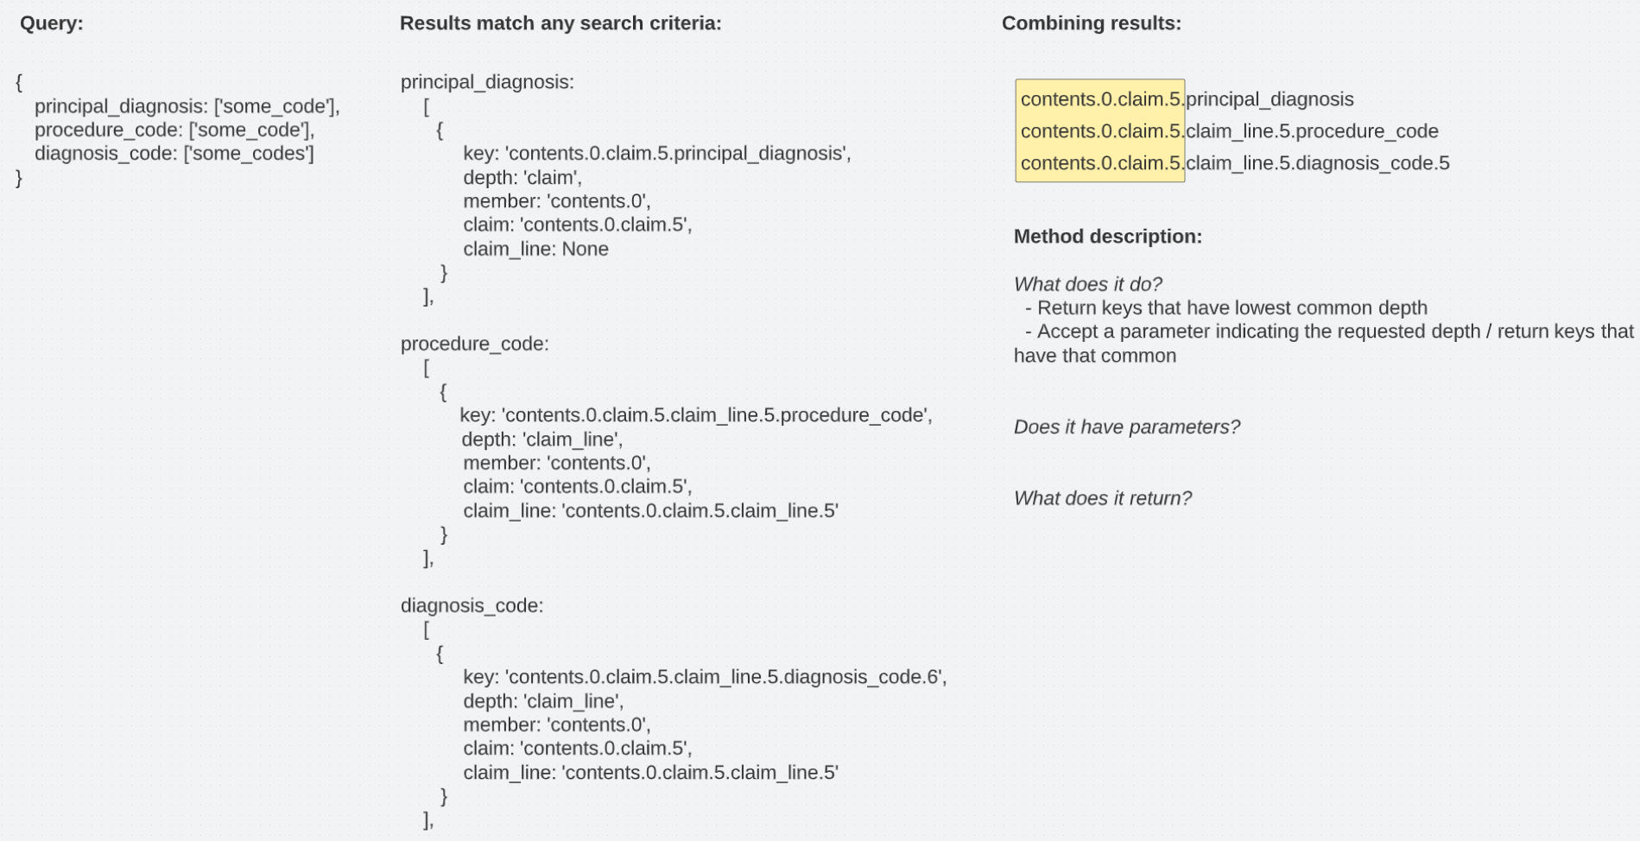
Class Methods
data.find_and({principal_diagnosis:[‘’], place_of_service: [‘11’]})
How does the method match keys?
- Matching on deepest common component of all keys
Does it have parameters?
- 1st: query
- 2nd: optional depth (member, claim, claim_line)
What does the method return?
- Depends on the parameters you pass it!
- Key component at the deepest possible level, or the level specified in the second parameter
xxx.find_and({search criteria}) -> ‘contents.0.claim.5.claim_line.5
xxx.find_and({search criteria}, ‘member’) -> ‘contents.0’
xxx.find_and({search criteria}, ‘claim’) -> ‘contents.0.claim.5’
What are you going to do with the results?
What information do you lose by returning the common element of all the keys?

